Slide 1
IT Infrastructure Architecture
Infrastructure Building Blocks
and Concepts
Networking – Part 2
(chapter 8)

Slide 2
Presentation layer

Slide 3
Presentation layer
This layer takes the data provided by the application layer and converts it into a standard format that the other layers can understand
Many protocols are implemented in the presentation layer
SSL and TLS are the most important ones

Slide 4
SSL and TLS
Allow applications to communicate securely over the internet using data encryption
Secure Sockets Layer (SSL)
SSL is considered insecure and should not be used
Transport Layer Security (TLS)
TLS is securing WWW traffic carried by HTTP to form HTTPS
Version 1.2 is considered secure
Version 1.3 is in a draft state
TLS relies on an application capable of handling the protocol (like a Web browser)

Slide 5
Application layer

Slide 6
Application layer
This layer interacts with the operating system or application
Examples:
HTTP
FTP
SMTP and POP3 (e-mail)
CIFS Windows file sharing

Slide 7
Application layer
This layer also contains the relatively simple infrastructure services
Examples:
BOOTP
DHCP
DNS
NTP
These infrastructure services are used by the infrastructure itself
Not necessarily used by upper layer applications
If infrastructure services fail, usually the entire infrastructure fails!

Slide 8
BOOTP and DHCP
BOOTP automatically assigns IP addresses to hosts
Uses a centralized BOOTP server
BOOTP requires manual configuration for each host in the network
DHCP is an extension to BOOTP
It superseded BOOTP because it has more options
DHCP dynamically assigns network related parameters to hosts:
IP addresses
Subnet masks
Default gateway to be used for routing
DNS server to be used
A DHCP assigned IP address has a limited life span
Typically a few hours
This is called a lease

Slide 9
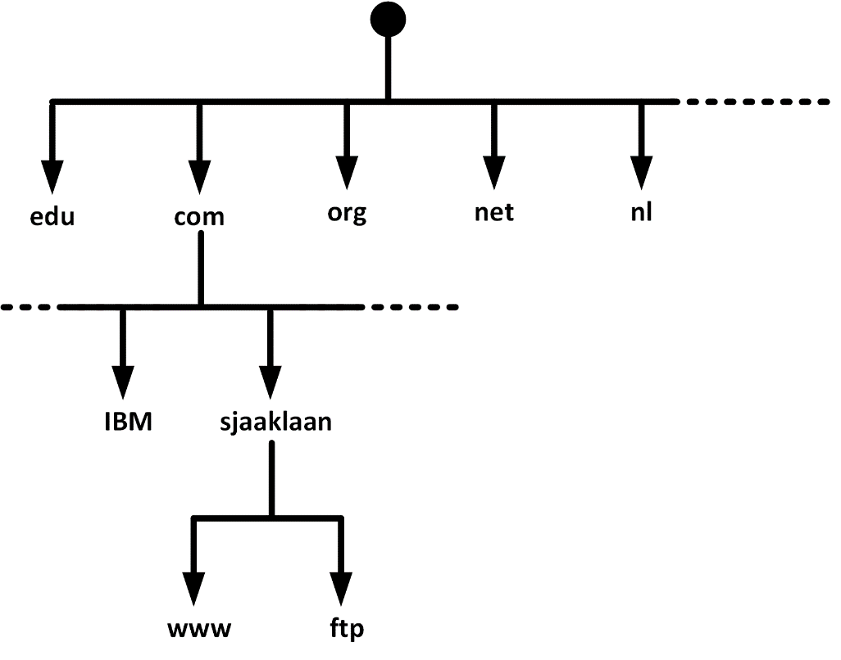
DNS
DNS is a distributed database that links IP addresses with domain names
Translates domain names, meaningful to humans, into IP addresses
For example, www.sjaaklaan.com is translated to 217.149.139.184
This IP address is used by the browser to connect to the web server
DNS distributes the responsibility of mapping domain names to IP addresses by designating authoritative name servers for each domain

Slide 10
DNSSEC
DNS has a number of security issues
DNS was not designed with security in mind
Updates to DNS records are done in non-encrypted clear text
Authorization is based on IP addresses only
DNSSEC is a set of extensions to DNS
Provides origin authentication of DNS data
Provides data integrity
DNSSEC is not in wide spread use today
All DNS servers must implement DNSSEC in order to make full use of all benefits

Slide 11
IPAM systems
IP address management (IPAM) systems are appliances that can be used to plan, track, and manage IP addresses in a network
IPAM systems integrate DNS, DHCP, and IP address administration in one high available redundant set of appliances

Slide 12
Network Time Protocol (NTP)
NTP ensures all infrastructure components use the same time in their real-time clocks
Particularly important for:
Log file analysis
Clustering software
Kerberos authentication
NTP can maintain time:
To within 10 milliseconds over the internet
Accurate to 0.2 milliseconds or better in LANs
When the time in an operating system is incorrect, the NTP client in the operating system changes the operating system clock

Slide 13
Network Time Protocol (NTP)
NTP servers can be implemented as:
Software on operating systems, routers, and switches
Dedicated hardware appliances – often using some external signal like long wave radio clocks or GPS clocks
NTP time synchronization services on the internet
NTP provides time in Coordinated Universal Time (UTC, previously known as GMT)
The translation to the local time zone, including the switch to and from daylight saving time, is done at the operating system level, not in NTP clocks

Slide 14
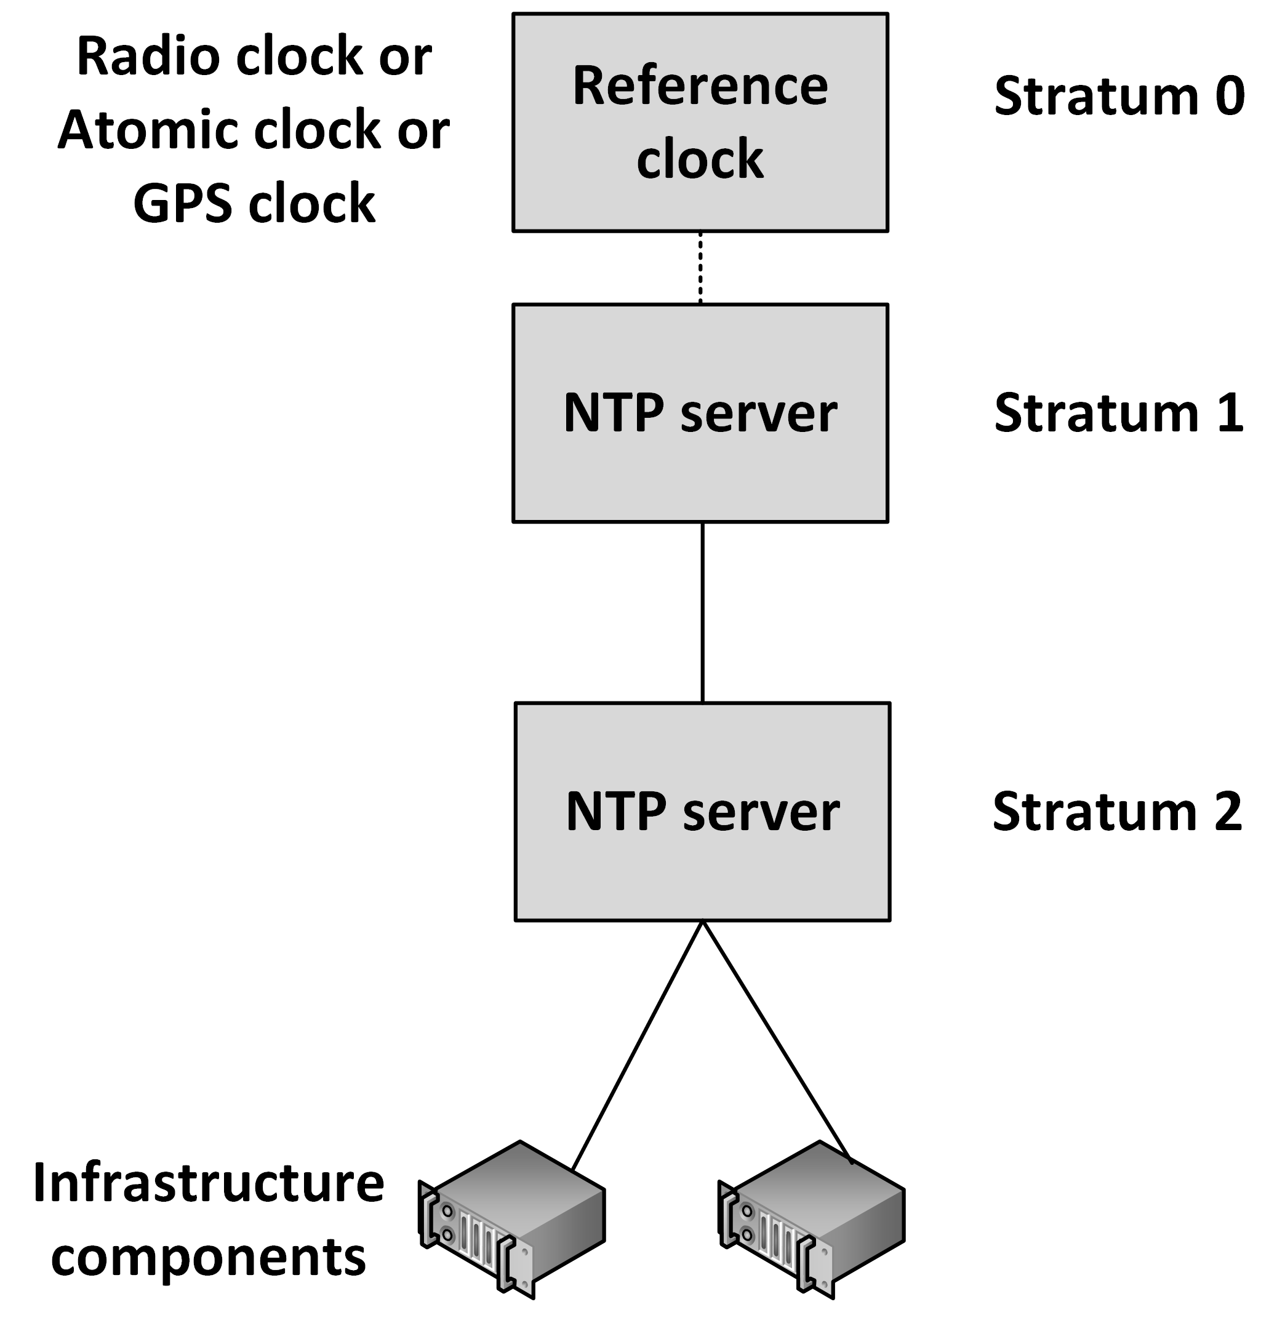
Network Time Protocol (NTP)
NTP operates within a hierarchy
Each level in the hierarchy is assigned a number called the stratum
The stratum defines its distance from the reference clock

Slide 15
Network virtualization

Slide 16
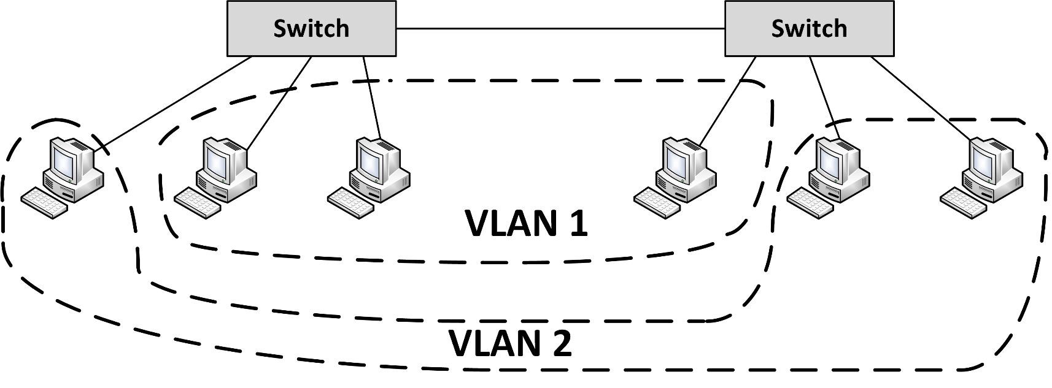
Virtual LAN (VLAN)
VLANs enable logical grouping of network nodes on the same LAN
Configured on network switches
Operate at the Ethernet level

Slide 17
Virtual LAN (VLAN)
VLANs:
Allow segmenting a network at the data link layer
Allow end stations to be grouped together even if they are not physically connected to the same switch
Can adapt to changes in network requirements and allow simplified administration
Enhance security by preventing traffic in one VLAN from being seen by hosts in a different VLAN
For VLANs to communicate with each other a router is needed

Slide 18
VXLAN
Virtual Extensible LAN (VXLAN) is an encapsulation protocol
Can be used to create a logical switched layer 2 network across routed layer 3 networks
Only servers within the same logical network can communicate with each other
VXLANs are heavily used in multi-tenant cloud environments

Slide 19
Virtual NICs
Virtual machines are only aware of virtual Network Interface Controllers (NICs) provided to them
Virtual machines running on physical machines share physical NICs
Communications between virtual machines on the same physical machine are routed directly in memory space by the hypervisor, without using the physical NIC
The hypervisor routes Ethernet packages from the virtual NIC on the virtual machine to the physical NIC on the physical machine

Slide 20
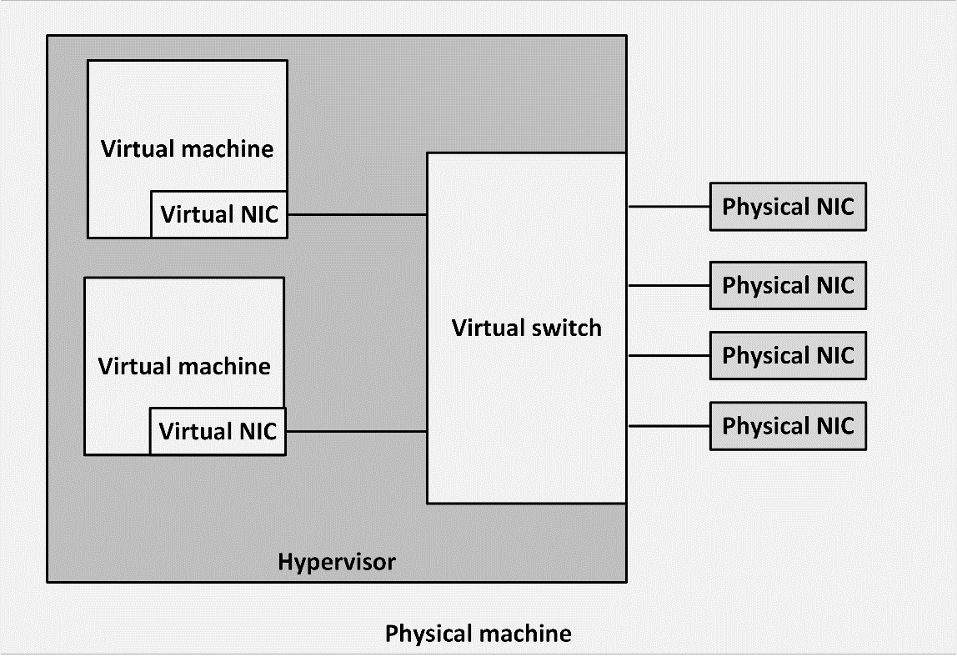
Virtual switch
Virtual NICs are connected to virtual switches
A virtual switch is an application running in the hypervisor, with most of the capabilities of a physical network switch
A virtual switch is dynamically configured
Ports in the virtual switch are configured at runtime
The number of ports on the switch is in theory unlimited

Slide 21
Virtual switch
Availability:
No cable disconnects
No need for auto-detecting network speed
No network hubs, routers, adapters, or cables that could physically fail
Security:
No easy way to intercept network communications between virtual machines from outside of the physical machine

Slide 22
Software Defined Networking
Software Defined Networking (SDN) allows networks to be defined and controlled using software external to the physical networking devices
A set of physical network switches can be programmed as a virtual network:
Hierarchical
Complex
Secured
A virtual network can easily be changed without touching the physical network components

Slide 23
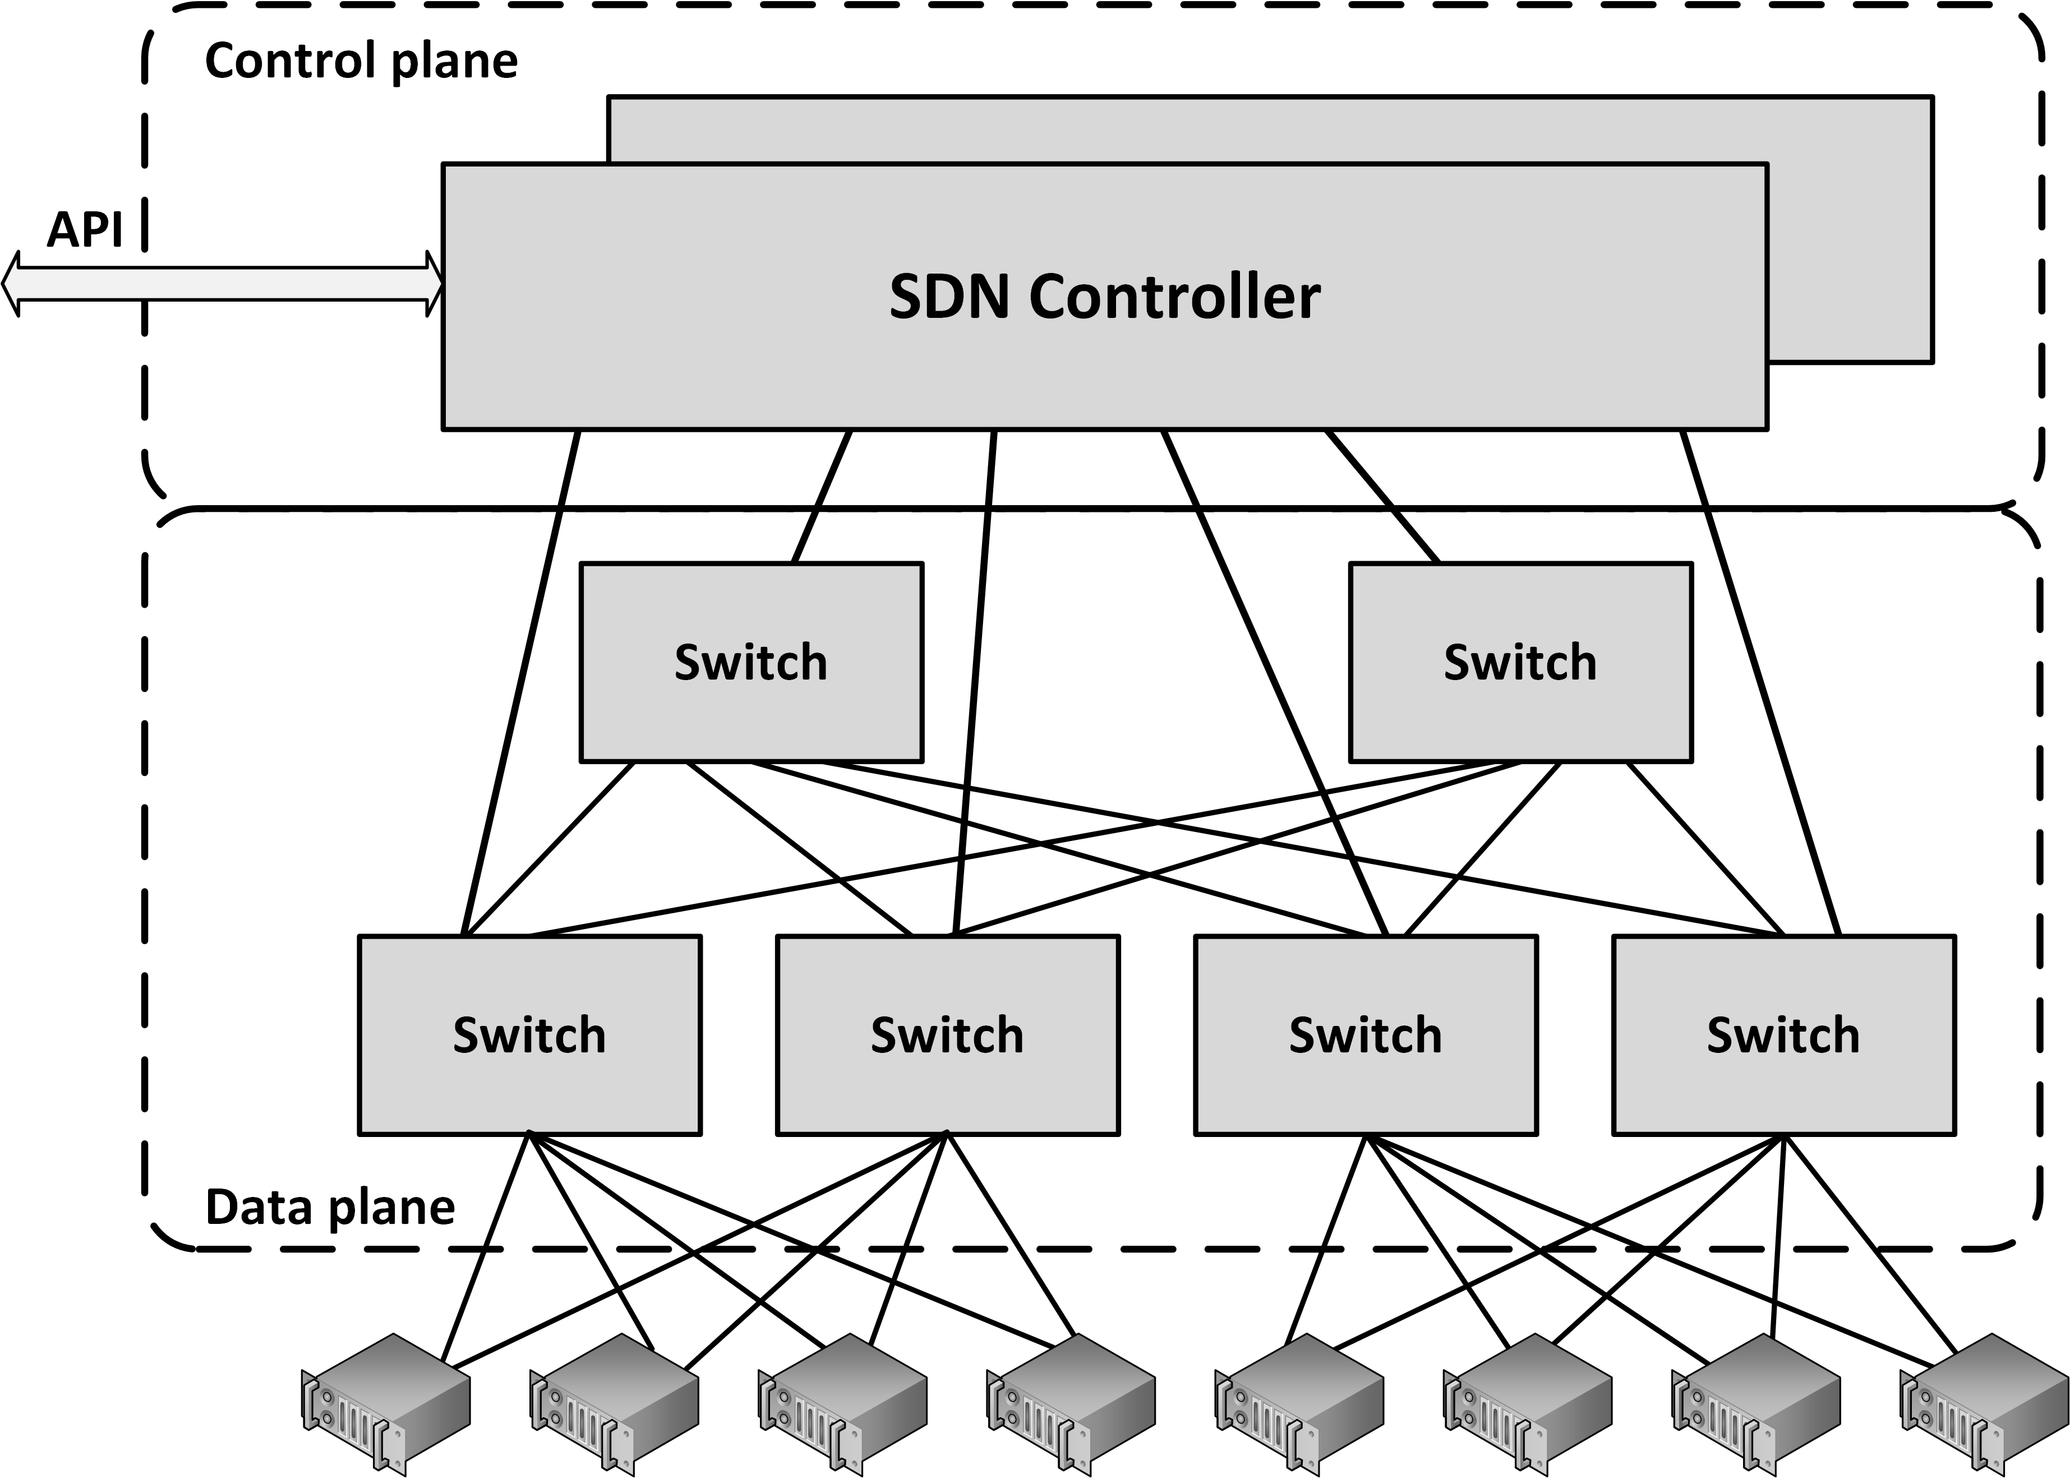
Software Defined Networking
Control plane resides centrally
Data plane (the physical switches) remain distributed

Slide 24
Software Defined Networking
SDN can be controlled from a single management console
Provides open APIs that can be used to manage the network using third party software
In an SDN, the distributed data plane devices are only forwarding network packets based on ARP or routing rules that are preloaded into the devices by the SDN controller in the control plane
This allows the physical devices to be much simpler and more cost effective

Slide 25
Network Function Virtualization
Network Function Virtualization (NFV) is a way to virtualize networking devices
Firewalls
VPN gateways
Load balancers
NFV appliances are implemented as virtual machines running applications that perform the network functions
NFV virtual appliances can be created and configured dynamically and on-demand using APIs
Example:
Deploy a new firewall as part of a script that creates a number of connected virtual machines in a cloud environment

Slide 26
Network availability

Slide 27
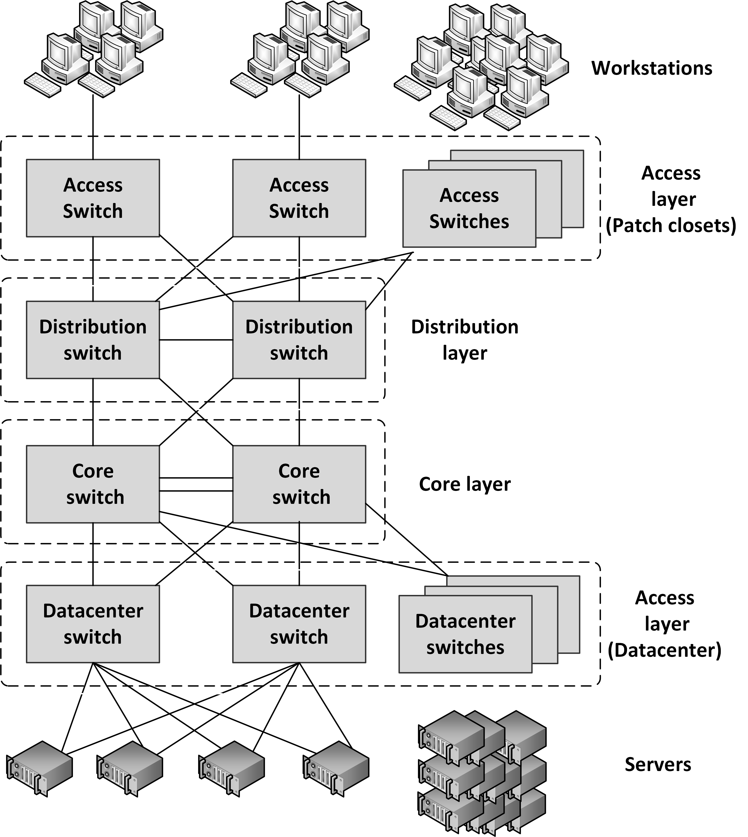
Layered network topology
A network infrastructure should be built up in layers
Improve availability and performance
Provides scalability
Provides deterministic routing
Avoids unmanaged ad-hoc data streams
Provides high availability
Because the layering provides multiple paths to any piece of equipment

Slide 28
Layered network topology
Core layer
This is the center of the network
Distribution layer
An intermediate layer between the core layer in the datacenter and the access switches in the patch closets
Combines the access layer data and sends its combined data to one or two ports on the core switches
Access layer
Connect workstations and servers to the distribution layer
For servers, located at the top of the individual server racks or in blade enclosures
For workstations, placed in patch closets in various parts of the building

Slide 29
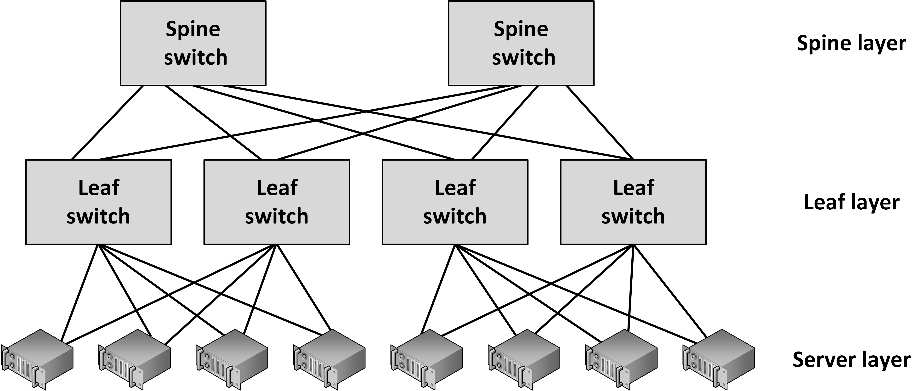
Spine and Leaf topology
In a SDN, a simple physical network is used that can be programmed to act as a complex virtual network
Such a network can be organized in a spine and leaf topology

Slide 30
Spine and Leaf topology
Characteristics:
The spine switches are not interconnected
Each leaf switch is connected to all spine switches
Each server is connected to two leaf switches
The connections between spine and leaf switches typically have ten times the bandwidth of the connectivity between the leaf switches and the servers

Slide 31
Spine and Leaf topology
Benefits:
Highly scalable
There are no interconnects between the spine switches
Simple to scale
Just add spine or leaf servers
With today’s high density switches, many physical servers can be connected using relatively few switches
Each server is always exactly four hops away from every other server
Leads to a very predictable latency

Slide 32
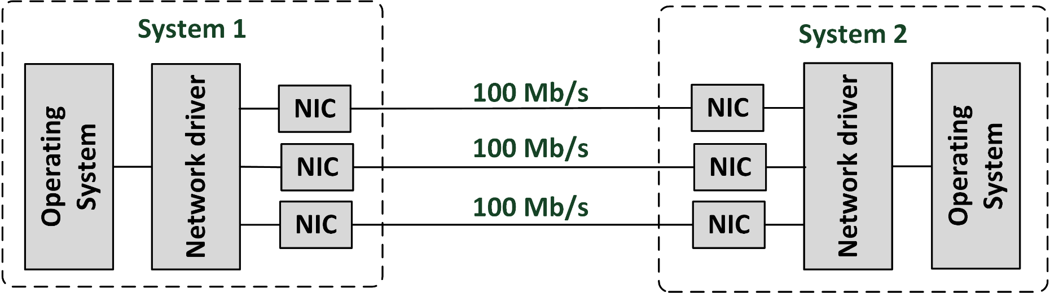
Network teaming
Network teaming is also known as:
Link aggregation
Port trunking
Network bonding
Provides a virtual network connection using multiple physical cables for high availability and increased bandwidth

Slide 33
Network teaming
Network teaming bonds physical NICs together to form a logical network team
Sends traffic to the team’s destination to all NICs in the team
Allows a single NIC, cable, or switch to be unavailable without interrupting traffic

Slide 34
Spanning Tree Protocol (STP)
STP is an Ethernet level protocol that runs on switches
Guarantees that only one path is active between two network endpoints at any given time
Redundant paths are automatically activated when the active path experiences problems
Ensures no loops are created when redundant paths are available in the network
A disadvantage of using the spanning tree protocol is that it is not using half of the network links in a network, since it blocks redundant paths
Rapid Spanning Tree Protocol (RSTP) provides for fast spanning tree convergence after a topology change (6 s instead of 30-60 s)

Slide 35
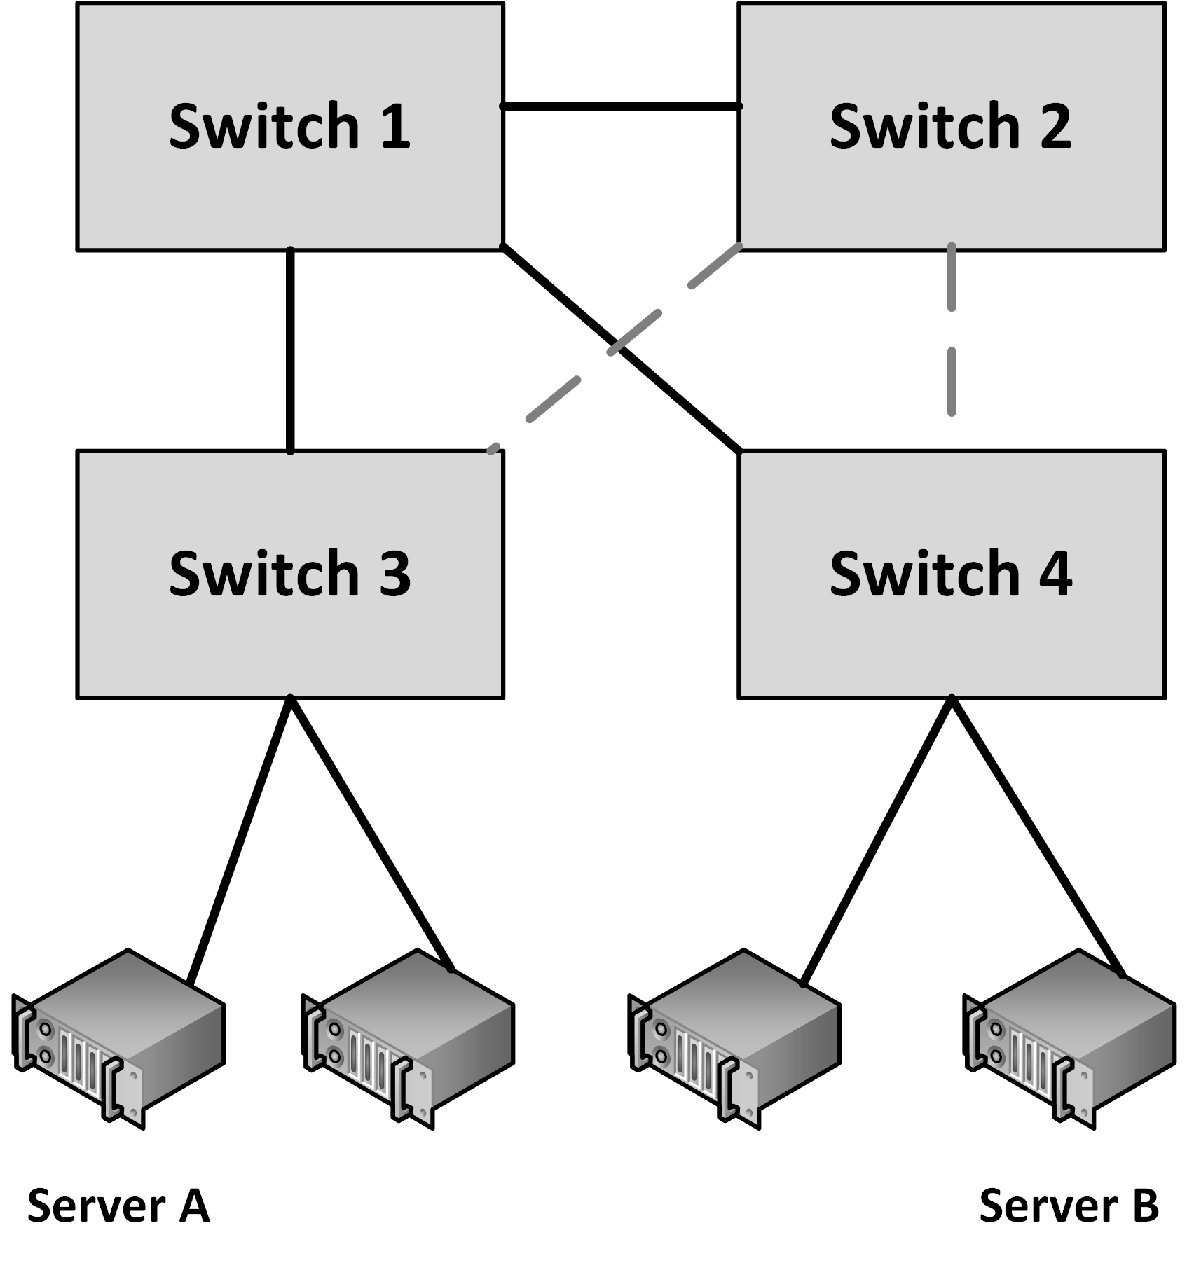
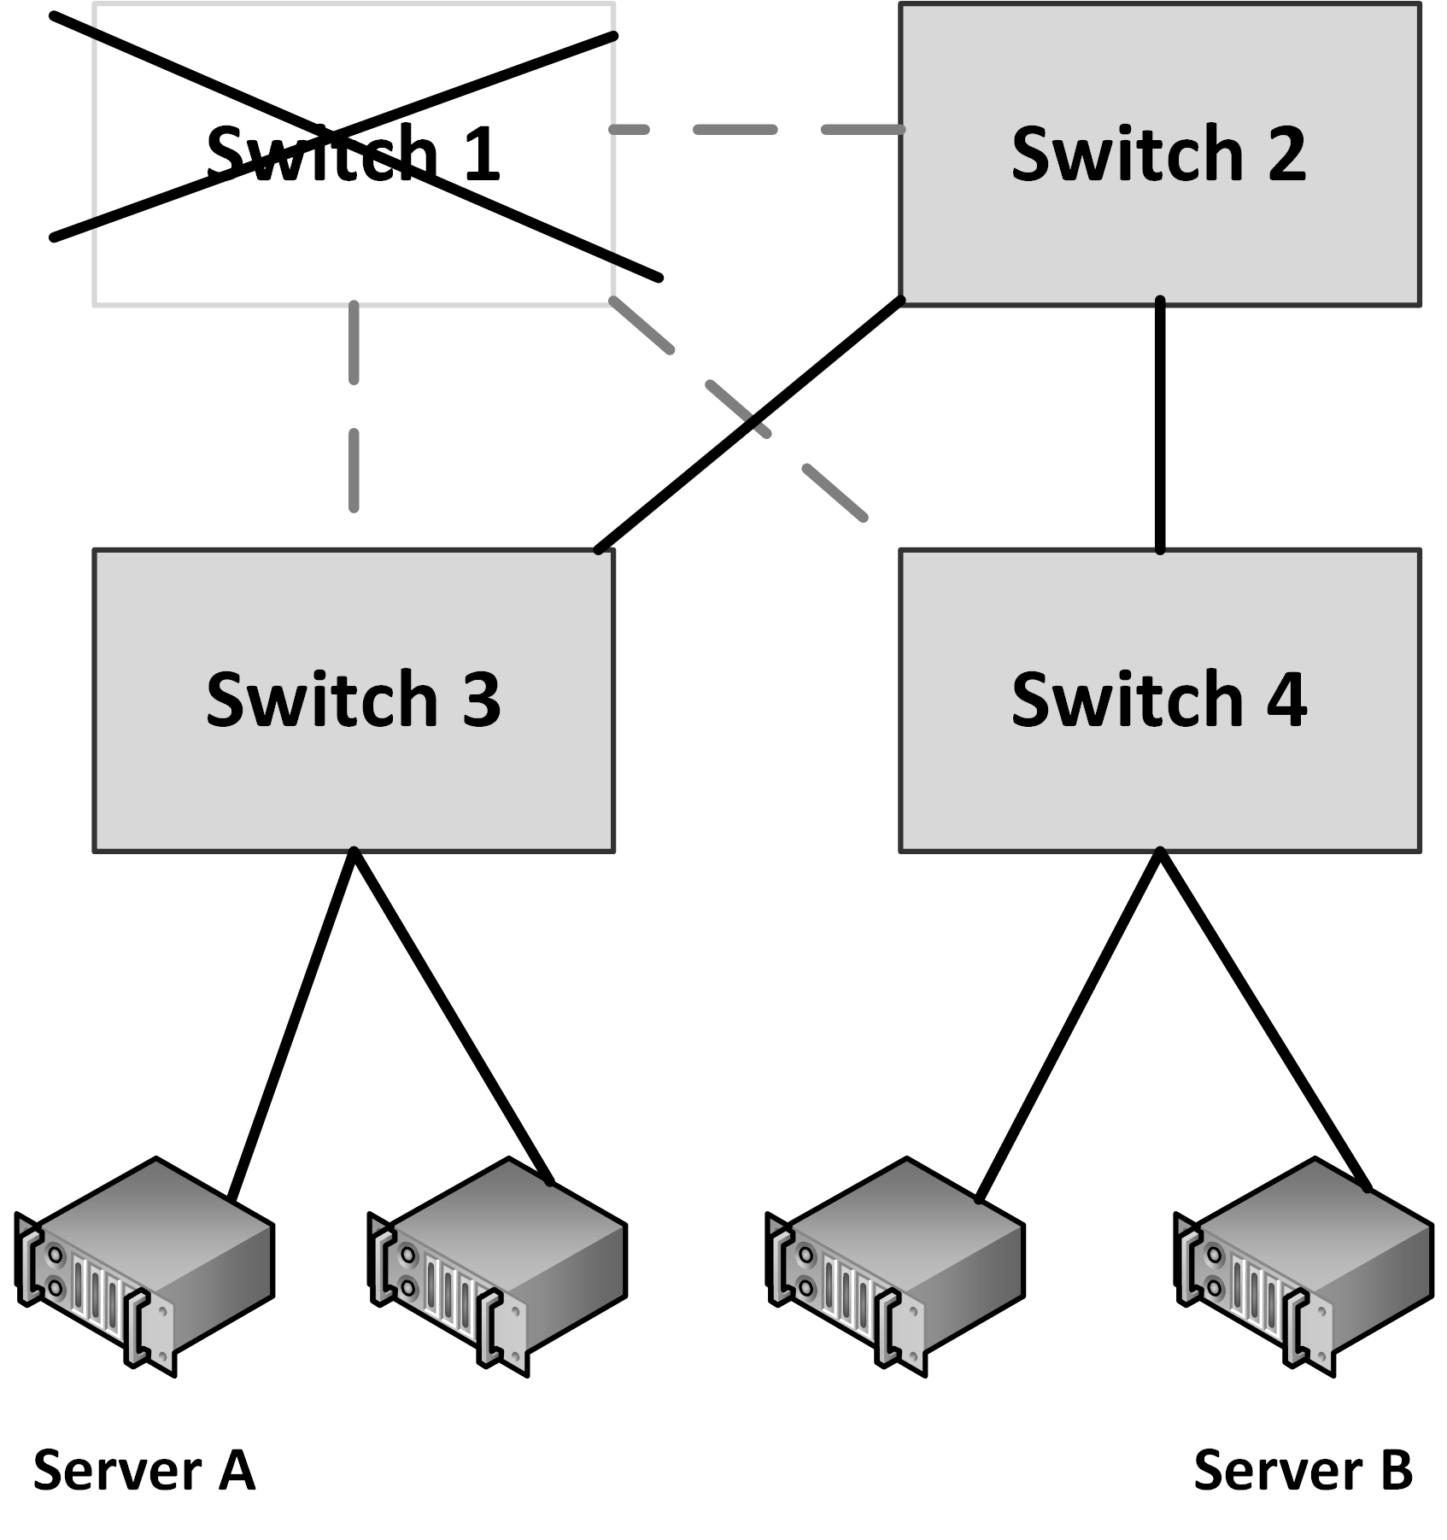
Spanning Tree Protocol

Slide 36
Multihoming
Connecting a network to two different Internet Service Providers (ISPs) is called multihoming
Four options for multihoming:
Single router with dual links to a single ISP
Single router with dual links to two separate ISPs
Dual routers, each with its own link to a single ISP
Dual routers, each with its own link to a separate ISP
It is not always guaranteed that multiple network paths actually run on a different set of cables
WAN cables are typically installed alongside highways and railway tracks
Cables are used by multiple carrier providers

Slide 37
Network performance

Slide 38
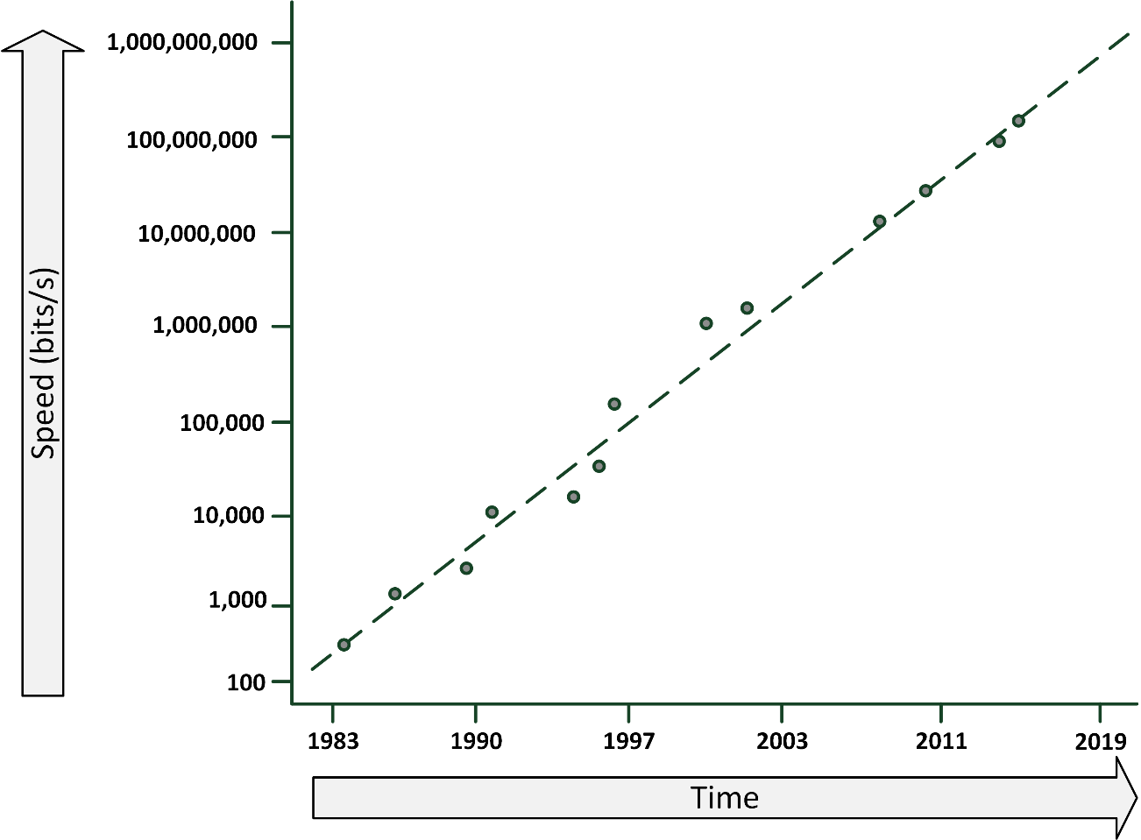
Nielsen’s law
Network connection speeds for high-end home users increase 50% per year, they double every 21 months
Bandwidths should be 15 Gbit/s in 2025, for about $50 per month
Please note that the vertical scale is logarithmic instead of linear

Slide 39
Throughput and bandwidth
Throughput is the amount of data that is transferred through the network during a specific time interval
Throughput is limited by the available bandwidth
When an application requires more throughput than a network connection can deliver:
Queues in the network components temporarily buffer data
Buffered data is sent as soon as the network connection is free again
When more data arrives than the queues can store in the buffer, packet loss occurs

Slide 40
Latency
Latency is defined as the time from the start of packet transmission to the start of packet reception
Latency is dependent on:
The physical distance a packet has to travel
The number of switches and routers the packet has to pass
Rules of thumb:
6 ms latency per 100 km
WANs: Each switch in the path adds 10 ms to the one-way delay
LANs: add 1 ms for each switch

Slide 41
Latency
One-way latency: the time from the source sending a packet to the destination receiving it
Round-trip latency: the one-way latency from source to destination plus the one-way latency from the destination back to the source
“ping” can be used to measure round-trip latency

Slide 42
Quality of Service (QoS)
Quality of service (QoS) is the ability to provide different data flow priority to different applications, users, or types of data
QoS allows better service to certain important data flows compared to less important data flows
QoS is mainly used for real-time applications like video and audio streams and VoIP telephony

Slide 43
Quality of Service (QoS)
Four basic ways to implement QoS:
Congestion management
Defines what must be done if the amount of data to be sent exceeds the bandwidth of the network link
Packets can either be dropped or queued
Queue management
When queues are full, packets will be dropped
Queue management defines criteria for dropping packets that are of lower priority before dropping higher priority packets

Slide 44
Quality of Service (QoS)
Link efficiency
Ensures the link is used in an optimized way
For instance by fragmenting large packets with a low QoS, allowing packets with a high QoS to be sent between the fragments of low QoS packets
Traffic shaping
Limiting the full bandwidth of streams with a low QoS to benefit streams with a high QoS
High QoS streams have a reserved amount of bandwidth

Slide 45
WAN link compression
Data compression reduces the size of data before it is transmitted over a WAN connection
WAN acceleration appliances:
Provide compression
Perform some caching of regularly used data at remote sites

Slide 46
Network security

Slide 47
Firewalls
Firewalls separate two or more LAN or WAN segments for security reasons
Firewalls block all unpermitted network traffic between network segments
Permitted traffic must be explicitly enabled by configuring the firewall to allow it
Firewalls can be implemented:
In hardware appliances
As an application on physical servers
In virtual machines
Host based firewalls
Protect a server or end user computer against network based attacks
Part of the operating system

Slide 48
Firewalls
Firewalls use one or more of the following methods to control traffic:
Packet filtering
Data packets are analyzed using preconfigured filters
This functionality is almost always available on routers and most operating systems
Proxy (also known as application layer firewalls)
A proxy terminates the session on the application level on behalf of the server (proxy) or the client (reverse proxy) and creates a new session to the client or server
Stateful inspection
Inspects the placement of each individual packet within a packet stream
Maintains records of all connections passing through the firewall and determines whether a packet is the start of a new connection, part of an existing connection, or is an invalid packet

Slide 49
IDS/IPS
An Intrusion Detection System (IDS) or Intrusion Prevention System (IPS) detects and – if possible – prevents activities that compromise system security, or are a hacking attempt
An IDS/IPS monitors for suspicious activity and alerts the systems manager when these activities are detected
An IPS can stop attacks by changing firewall rules on the fly

Slide 50
IDS/IPS
Two types of IDS/IPS systems:
A Network-based IDS (NIDS) is placed at a strategic point in the network
Monitors traffic to and from all devices on that network
The NIDS is not part of the network flow, but just “looks at it”, to avoid detection of the NIDS by hackers
A Host-based IDS (HIDS) runs on individual servers or network devices
It monitors the network traffic of that device
It also monitors user behavior and the alteration of critical (system) files

Slide 51
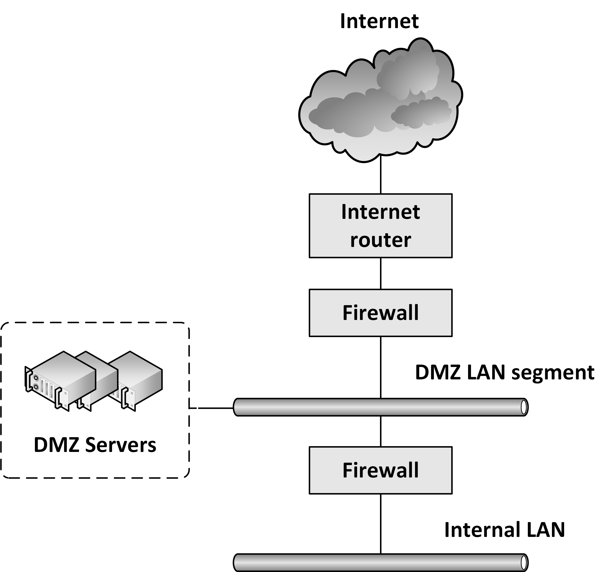
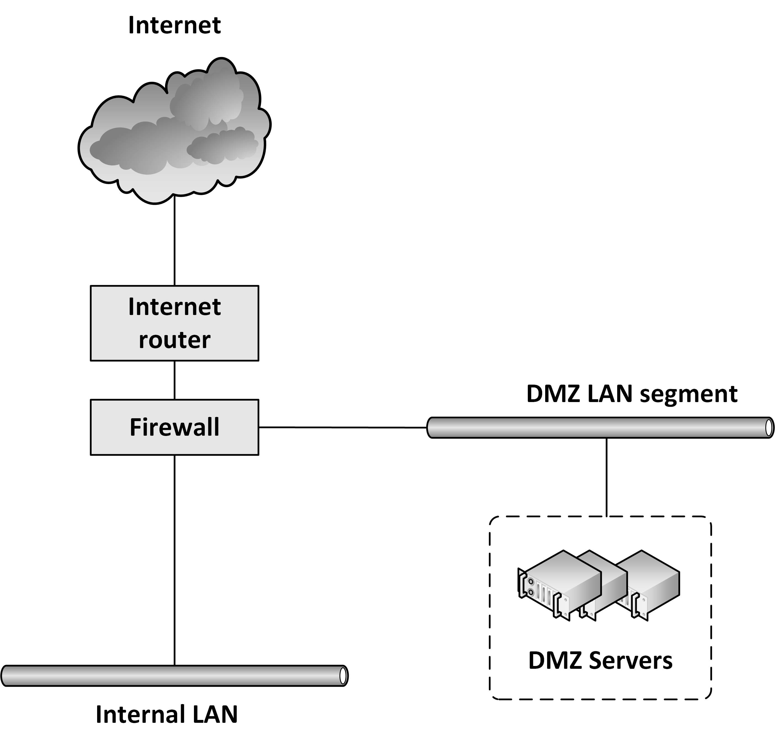
DMZ
DMZ is short for De-Militarized Zone, also known as screened subnet, or the Perimeter Network
A DMZ is a network that serves as a buffer between a secure protected internal network and the insecure internet

Slide 52
RADIUS
Remote Authentication Dial In User Service (RADIUS) is a networking protocol that provides centralized user and authorization management for network devices
Routers
Modem servers
Switches
VPN routers
Wireless network access points
RADIUS
Authenticates users or devices before granting them access to a network
Authorizes users or devices for certain network services

Slide 53
Network Access Control (NAC)
Network Access Control (NAC) is used at the network end points, where end user devices (like laptops) can be connected to the network
It allows predefined levels of network access based on:
A client's identity (is the laptop known to the organization?)
The groups to which a client belongs
The degree to which a client’s device complies with the organization's governance policies (does it run the most recent virus scanner?)

Slide 54
Network Access Control (NAC)
If a client device is not compliant, NAC provides a mechanism to automatically bring it into compliance
For instance:
Installing the latest virus scanner updates while connected on an isolated LAN segment
After the update finishes, access is granted to the rest of the network

